Slide 1


Informativeness of motor response dynamics in optimal stopping problems
Ilkka Leppänen
Aalto University School of Business
Finland
Tianqi Hu
Loughborough University Business School
United Kingdom

Slide 2
Contents
Sequential decision problems
Two optimal stopping problems:
Rank dependent sequential search (the classical secretary problem)
Revenue management problem
Experimental design with the two stopping problems
Response dynamics and design of experimental apps
Results from ongoing experiments

Slide 3
Sequential decision problems
Decision opportunities are presented in a sequence
The decision maker must choose to
Accept an opportunity and enjoy the payoffs that it brings
Reject an opportunity and move to the next one without recall
Information on the order of opportunities is (often) incomplete
The decision maker may not know (much about) the distribution from which the opportunities are drawn
Behavioural anomalies: people tend to stop searching too early, or rely on heuristics instead of optimal decision rules

Slide 4
Sequential observation and selection with rank dependent payoffs (classical secretary problem)
Candidates can be ranked in terms of their abilities
The DM observes candidates one by one but only knows the relative ranks (w.r.t. thus far observed candidates)
Only one candidate is selected
Various forms of this problem exist in the literature (see Bearden et al. 2006) and the optimal policy depends on how the payoff function is formulated
Notes:
In one format of the CSP, the first 37% of the applicants should be straightforwardly rejected and then choose the next applicant that has a relative rank that brings positive payoff

Slide 5
Sequential observation and selection with rank dependent payoffs (classical secretary problem)
Our study follows Bearden et al. (2006)
60 candidates, each with different abs. rank = 1 to 60
On each round observe a random candidate and its relative rank
Block ends either on acceptance or after 60 rounds; total 60 blocks
After each block show the full order of absolute ranks
Payoffs: £25 for the best, £13 for the 2nd best, £6 for the 3rd best, £3 for the 4th best, £2 for the 5th best, £1 for the 6th best, £0 for anyone else
Optimal decision rule: reject the first 20 applicants, then apply an acceptance threshold rule
Rel. rank: | 1 | 2 | 3 | 4 | 5 | 6
Round: | 21 | 43 | 53 | 57 | 58 | 59
(Bearden et al. 2006)

Slide 6
Revenue management problem
The DM is endowed with N perishable items to sell over a selling season of T rounds
Randomly distributed bids arrive sequentially, one on each round with probability p
DM maximises total revenue from sold items
Optimal policy given by a DP solution and based on dynamic thresholds: accept bid if over threshold, otherwise reject (e.g. Lee & Hersh 1993)

Slide 7
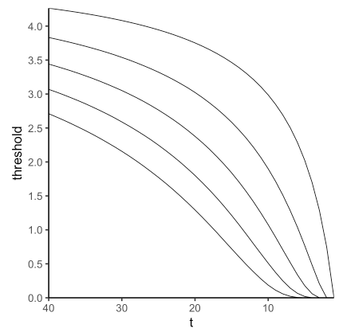
Revenue management problem
Optimal thresholds: DM has more pressure to accept when they have more units left and less time left
Our study follows Bearden et al. (2008)
5 widgets to sell over T = 40 rounds
Bids follow Uniform(£0.01, £5.00) and arrive with probability p = 30%
DM tasked to accept or reject each bid
Block ends either when widgets are sold or rounds are full
Repeated for 30 blocks
1 item left
5 items left

Slide 8
Methodology

Slide 9
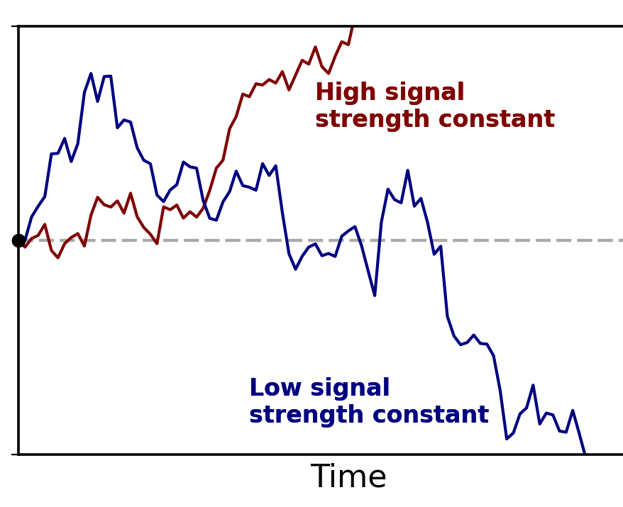
Evidence accumulation
Choice among few options can be modelled as the process of accumulating evidence towards different options
Many types of sequential sampling models (SSMs), e.g.
Drift Diffusion Model (DDM)
Linear Ballistic Accumulator Model
In decision making research, SSMs allow using choice and response time data to make predictions
Model parameters have connections to interesting behavioural phenomena, such as loss aversion (Clay et al. 2017)
accept
reject
response time

Slide 10

Motor response dynamics
Decision making relies on higher-level cognition that depends on processes of perception, attention, and memory
The motor movement (spatial extent and temporal dynamics) is indicative of higher-level cognition (McKinstry et al. 2008)
Continuous, online processing of information and accumulation of evidence is captured by tracing motor movement patterns (Stillman et al. 2020)
reject
accept
start

Slide 11
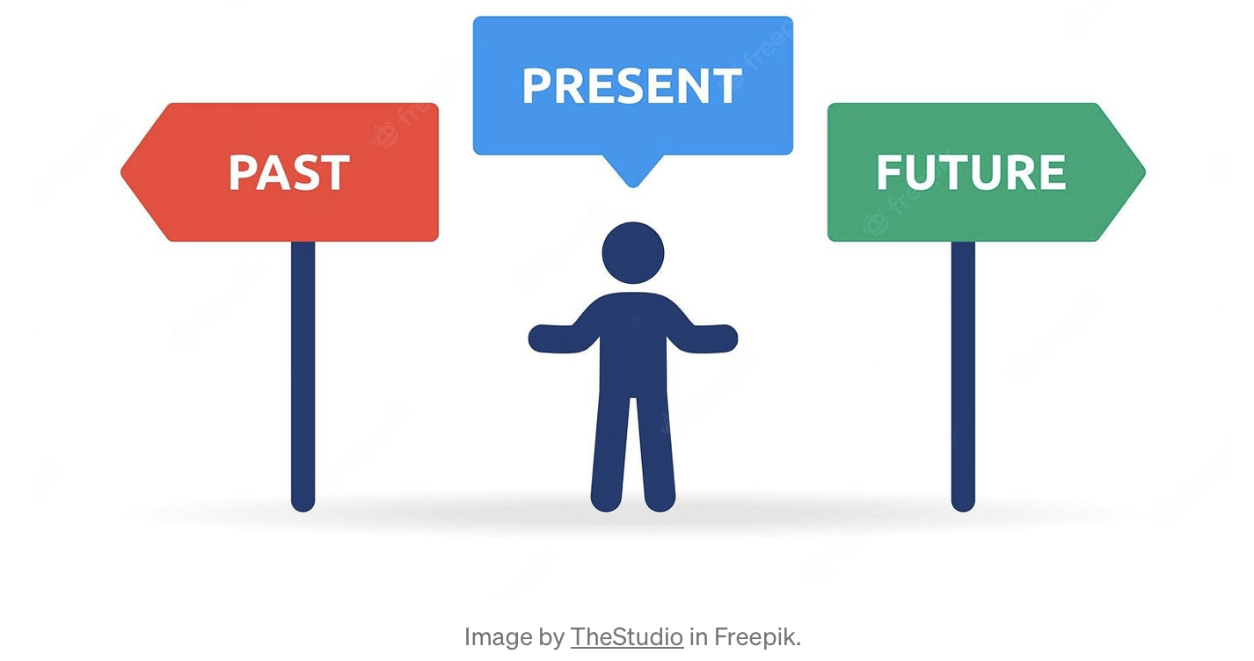
Swiping left & right
A ubiquitous, natural way of interacting with online mobile devices, used by hundreds of different apps and websites
Swiping left is associated with going backward, or dismissal
Swiping right is associated with going forward, or progress
“One day I was wiping my foggy mirror after getting out of the shower and found my inspiration.” - Jonathan Badeen, co-founder of Tinder

Slide 12

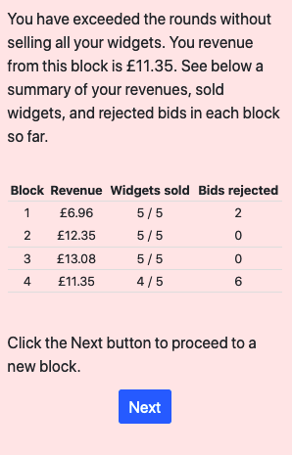
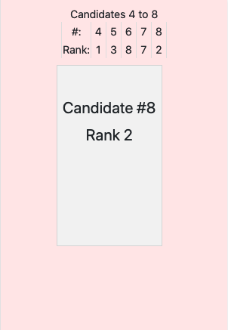
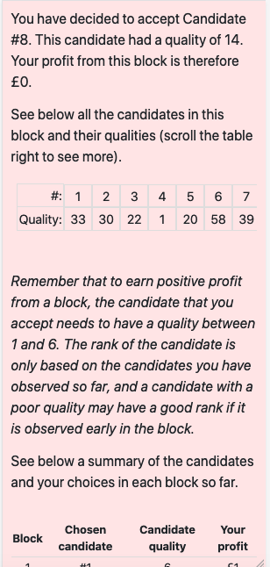
Apps developed with oTree
Revenue Management App
Sequential Search App
Swipe box left to reject bid/candidate
Swipe box right to accept bid/candidate

Slide 13


Slide 14
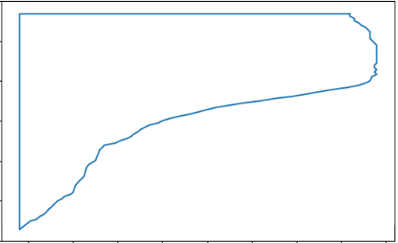

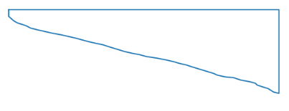
Motor response dynamics: swipe tracking and its connections to evidence accumulation
start
polygon
Drift Diffusion Model (DDM)
y-coordinate: time
accept
end
x-coordinate: swipe path
start
polygon
reject
y-coordinate: time
response time
end
The latent DDM is physically manifested in motor responses tracked by the ‘swipes’
i.e. the evidence accumulation process is reflected by the swipe movement
x-coordinate: swipe path
Notes:
Decision times
Polygon area: area drawn by the x-y-coordinates, where y = decision time and x = horizontal movement pattern of the box
Looking times: how long the DM has looked at the ‘accept’ option relative to the ’reject’ option

Slide 15
Results

Slide 16
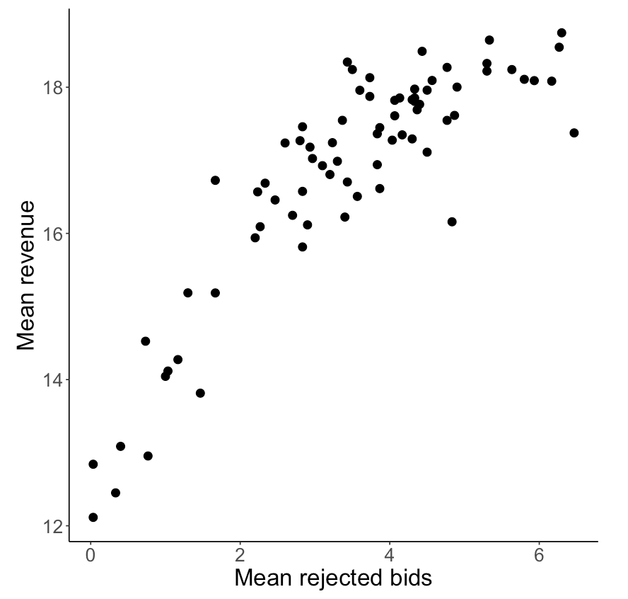
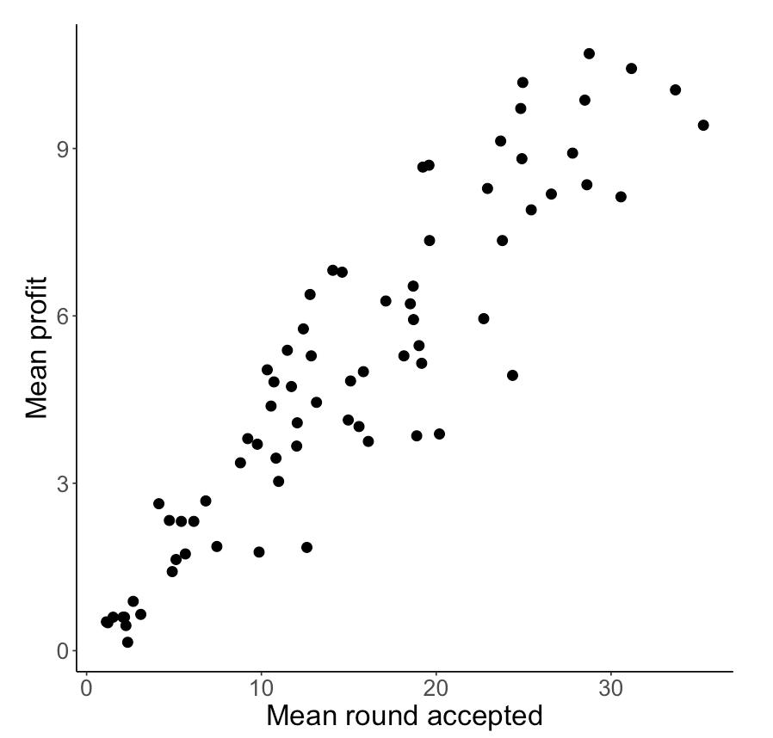
Behavioural results: depth of search affects performance
Revenue management
Sequential search
RQ: What can motor response dynamics say about the process of rejections?
Notes:
Studying the process of rejections should be interesting

Slide 17
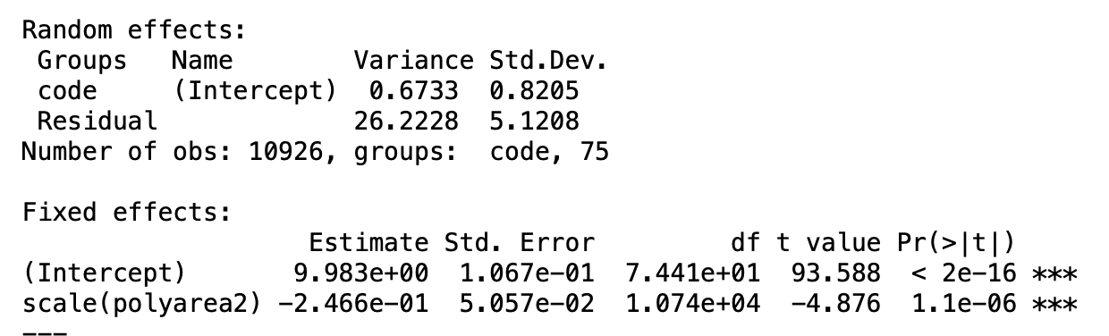
How deliberation affects performance
The more the DM deliberates the swipe (the higher the polyarea), the less revenue they earn in the revenue management problem
(This is not significant in the sequential search problem)
Notes:
Here we restrict only to accepted candidates, because rejected candidates do not change revenue/profit
This is used to get an aggregate summary of the results

Slide 18
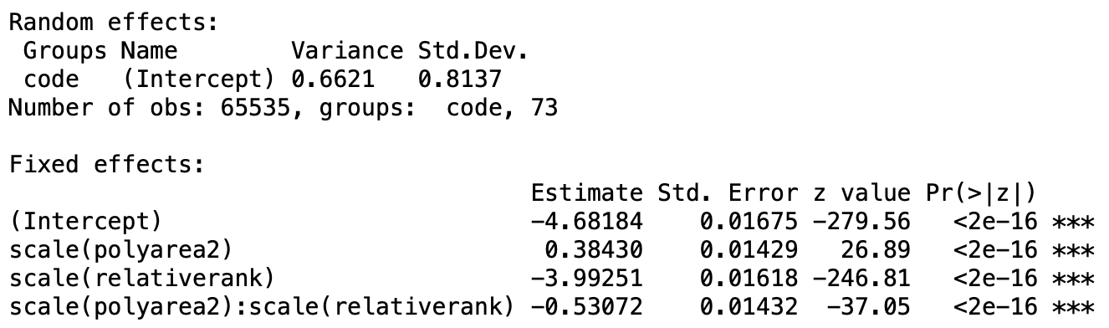
Relative ranks and deliberation
Relative rank is displayed when making decisions in the sequential search problem, therefore it is expected that it affects the decision
Deliberation (polyarea) has direct effect on accepting
Interestingly, relative rank moderates the effect of polyarea on accepting: the higher relative rank is, the less effect polyarea has on acceptance
Logit model DV = accept
Notes:
Intecept negative: mostly rejectings (swipes left)
Accepting increases in polyarea
Accepting decreases in relative rank
But higher relative rank makes the impact of polyarea on accepting less severe

Slide 19
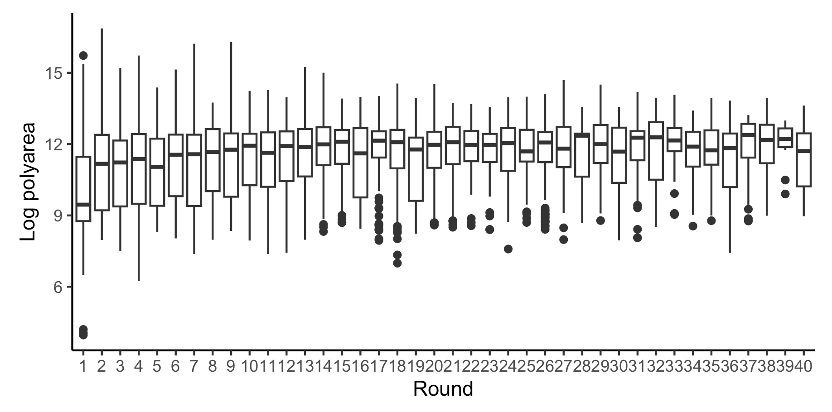
Deliberation with early applicants in the sequential search problem
Bearden et al. (2006) conclude that DMs overestimate the early applicants and fail to give enough weight to better applicants that are yet to come
We find that this is because DMs tend to deliberate the swipe over early applicants who should be rejected without any hesitation
Notes:
polyarea ~ blockround => if negative then there is more deliberation in the early applicants than in the later applicants

Slide 20
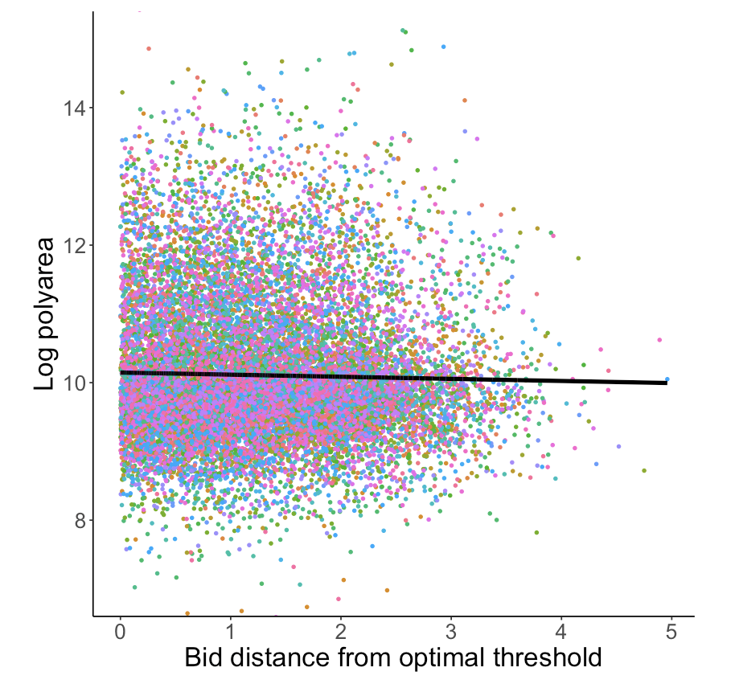
Near threshold swipe behaviour
Bids near thresholds generate deliberation and conflict because these environments force assessing whether the “real” threshold is exceeded or not
Line = common slope from an LMM with random intercepts (slope neg. p = 0.00147)
Dots = conditional residuals of each subject differentiated by colour
Notes:
The slope is negative!
Dots are calculated by taking the common marginal fit and adding to that each subject’s conditional residual

Slide 21
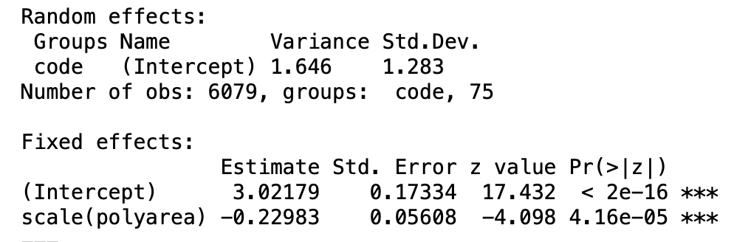
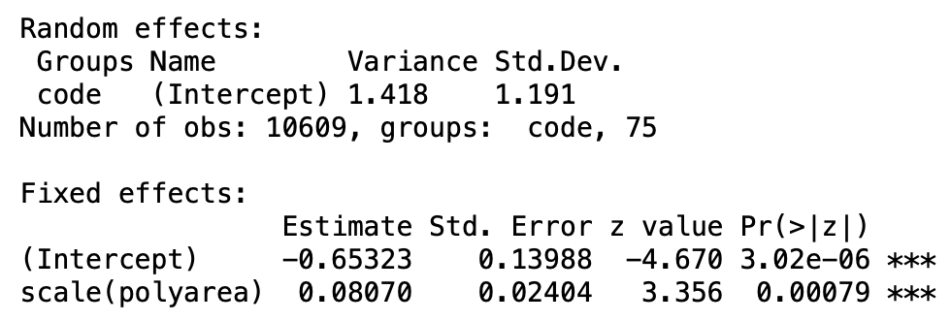
Swipe behaviour and decision errors
When bid is above threshold (Logit model, DV = accept)
DM is more likely to reject if polyarea is high
A higher polyarea predicts more incorrect reject decisions (when the bid should be accepted)
A higher polyarea predicts more incorrect accept decisions (when the bid should be rejected)
This holds for both the optimal threshold as well as a range of fixed thresholds (e.g. £2.5)
When bid is below threshold (Logit model, DV = accept)
DM is more likely to accept if polyarea is high
Notes:
In the

Slide 22
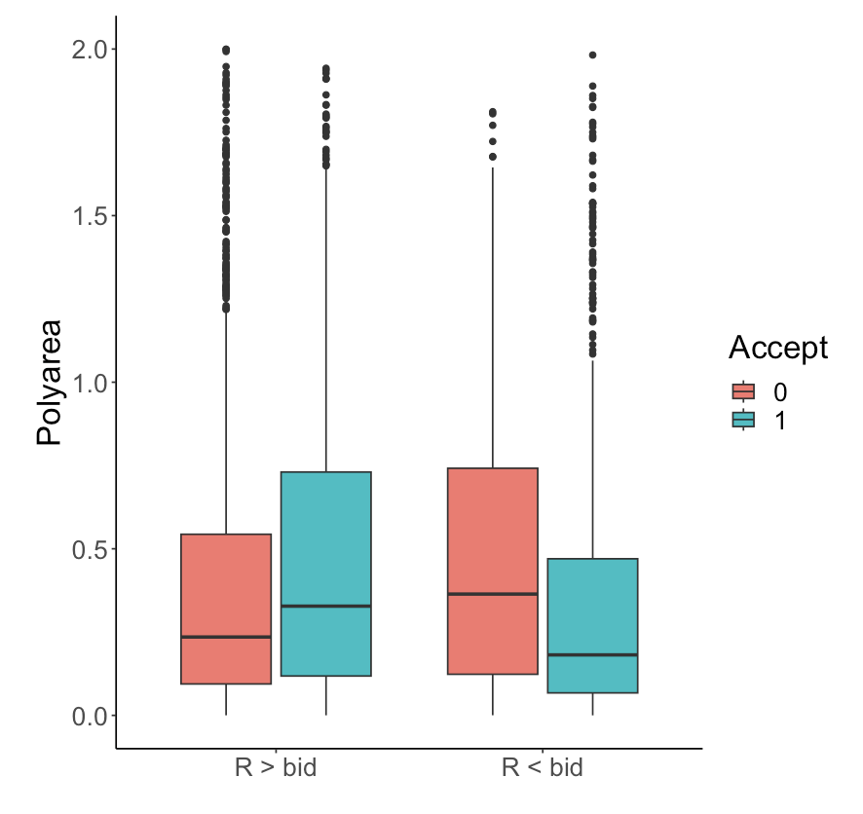
Swipe behaviour and decision errors
A higher polyarea predicts more incorrect reject decisions (when the bid should be accepted)
A higher polyarea predicts more incorrect accept decisions (when the bid should be rejected)
This holds for both the optimal threshold as well as a range of fixed thresholds (e.g. £2.5)
(bid should be rejected)
(bid should be accepted)
Notes:
In the

Slide 23
Conclusions
Inspecting motor movements provide a window into the higher-level cognitive processes that are needed in decision making
Process tracing provides a scalable and accessible tool that can covertly and cheaply reveal process data that can be used as modelling inputs in a variety of settings where choice conflict and deliberation over the best course of action is involved
decision outcomes
Model
(e.g. Prospect Theory)
decision outcomes
Model
(e.g. Drift Diffusion Model with Prospect Theory)
predictions
decision outcomes
Model
(TBA)
response times
predictions
predictions
response times
motor responses

Slide 24
Literature
Bearden, J.N., Rapoport, A. and Murphy, R.O., (2006). Sequential observation and selection with rank-dependent payoffs: An experimental study. Management Science, 52(9), pp. 1437-1449.
Bearden, J.N., Murphy, R.O. and Rapoport, A., (2008). Decision biases in revenue management: Some behavioral evidence. Manufacturing & Service Operations Management, 10(4), pp. 625-636.
Clay, S. N., Clithero, J. A., Harris, A. M., & Reed, C. L. (2017). Loss aversion reflects information accumulation, not bias: A drift-diffusion model study. Frontiers in psychology, 8, 1708.
Lee, T. C., M. Hersh. 1993. A model for airline seat inventory control with multiple seat bookings. Transportation Science 27, 1252–1265.
Stillman, P. E., Krajbich, I., & Ferguson, M. J. (2020). Using dynamic monitoring of choices to predict and understand risk preferences. Proceedings of the National Academy of Sciences, 117(50), 31738-31747.

